Slide 1
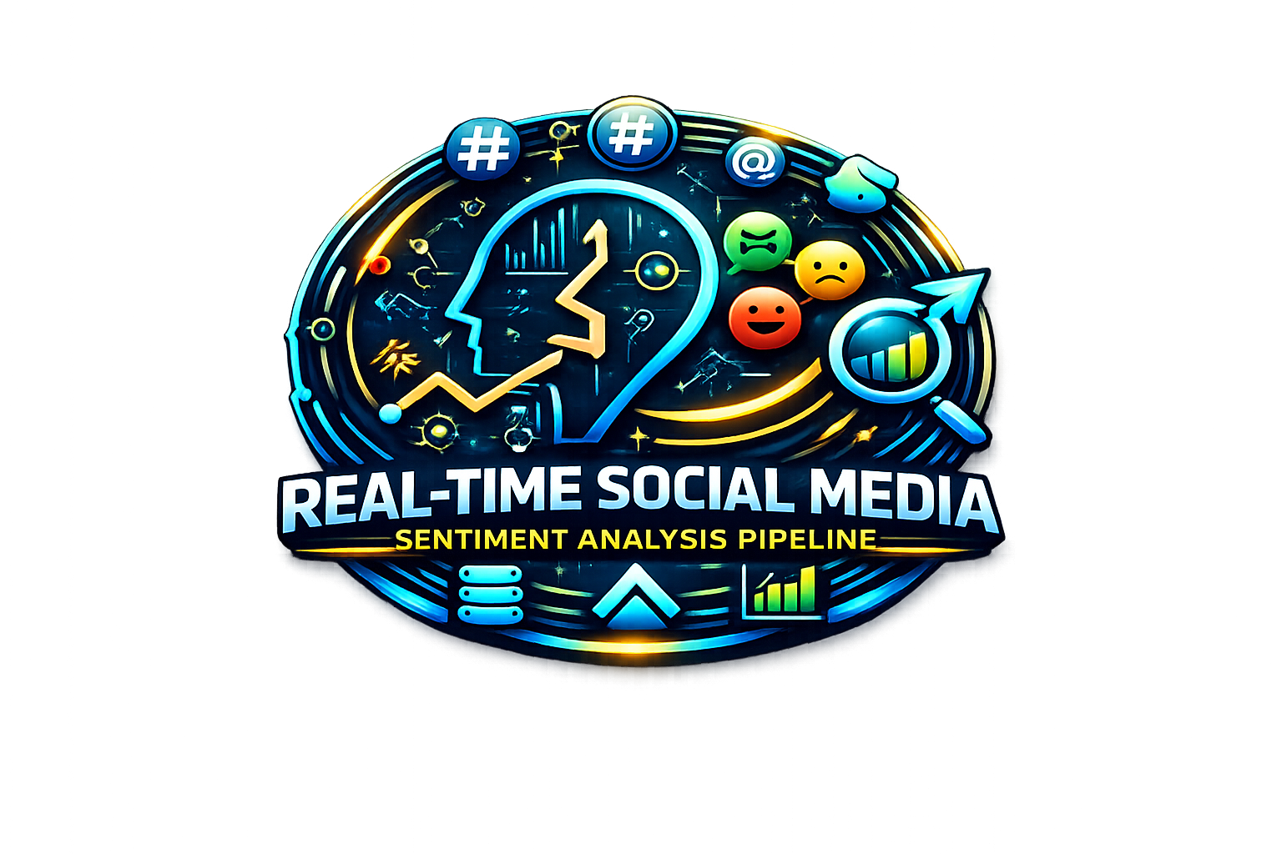

Slide 2

Real-Time Social Media
Sentiment Analysis Pipeline
A Scalable ETL Data Engineering Project
Presented by
Gullanki Vara Naga Sai Sree • Peruri Sireesha • Sahana P • Subhadip Sasmal

Slide 3




Project Overview
1
2
3
Ingest
Process
Analyse
Processed data is analysed using sentiment models to extract insights like topic trends, engagement patterns, and influencer impact — visualized through Databricks Lakeview Dashboards
Raw tweets are streamed in real-time through AWS Kinesis, capturing live social media data continuously without any delays.
Data is cleaned, filtered, and structured using Databricks — removing noise, handling duplicates, and transforming it into Delta Tables via a Bronze → Silver → Gold pipeline.
Real-Time Social Media Sentiment Analysis Pipeline
2 / 17

Slide 4








Technologies Used
Databricks
PySpark
Delta Lake
GitHub
Apache Airflow
Slack Alerts
SQL Analytics
AWS S3 / Kinesis
Real-Time Social Media Sentiment Analysis Pipeline
3 / 17

Slide 5
Dataset Information
Source: Kaggle — US Election 2020 Tweets
• Storage: AWS S3 (s3-socialmedia-trgt-buckt)
• Format: CSV → Parquet
• Tables: tweets, sentiment, trends, user_metadata, valid_tweets
• Key Fields: tweet_id, user_id, text, sentiment, timestamp
CSV → Parquet
CSV (S3) → Kinesis → Firehose → Parquet → S3(target) → Databricks
Real-Time Social Media Sentiment Analysis Pipeline
4 / 17

Slide 6
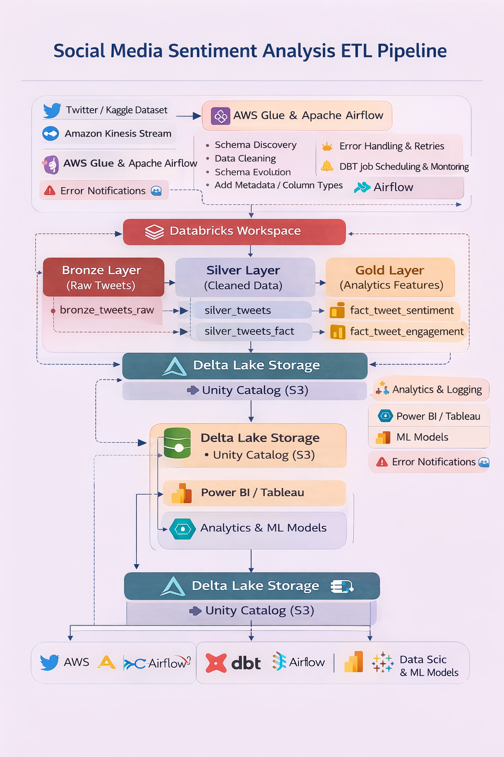
High-Level Architecture
1. Ingestion — Two sources feed data in parallel. S3 handles batch workloads (files dropped periodically), while Kinesis handles real-time streaming events. Both paths converge at the conversion step.
2. Convert — Raw data from both sources gets serialized into Parquet format — a columnar, compressed file format that makes downstream querying significantly faster and cheaper.
3. Delta Lake (Medallion Architecture) — Data is refined in 3 progressive layers:
Bronze → raw data landed as-is, no transformations. Your source of truth.
Silver → data is cleaned, deduplicated, and validated. Joins and type-casting happen here.
Gold → business-aggregated, ready-to-query tables. Think KPIs, rollups, and domain-specific views.
4. Consume — Gold layer tables are exposed directly to BI tools like Tableau, Power BI, or Looker for dashboards and reporting.
Real-Time Social Media Sentiment Analysis Pipeline
5 / 17

Slide 7



Medallion Architecture
Data is organized into three layers — progressively improving quality and structure.
BRONZE
SILVER
GOLD
Raw Ingestion
Cleaned & Enriched
Analytics Ready
Raw data stored exactly as received from source. Schema inferred, timestamps and IDs preserved as-is.
Data cleaning, type casting, deduplication, and enrichment. Joins produce the valid_table.
Aggregated datasets optimized for reporting. Feature engineering via dbt transforms.
Tables
Tables
Tables
tweets_table
silver_tweets
fact_tweet
user_metadata_table
silver_metadata_table
fact_trend
sentiment_table
silver_sentiment
dim_user
trends_table
silver_trends
dim_topic
valid_table
silver_valid
dim_country
Real-Time Social Media Sentiment Analysis Pipeline
6 / 17

Slide 8
Bronze Layer — Raw Data
Stores raw ingested data exactly as received from the source — no transformations applied.
Tables
Ingestion Details
tweets_table
1
Load Raw Data
1
Load raw tweet, user, sentiment & trend data from CSV files stored in AWS S3.
user_metadata_table
2
Schema Inference
2
Detect column types automatically. Timestamps stored as STRING, scores as DOUBLE, IDs as STRING.
sentiment_table
3
Add Ingestion Timestamp
3
Append ingested_at column on every record to track when data entered the pipeline.
trends_table
4
Validate File Structure
4
Output clean records to valid_table and flag malformed rows for review.
valid_table
5
Real-Time Social Media Sentiment Analysis Pipeline
7 / 17

Slide 9
Silver Layer — Clean Data
Performs data cleaning, validation, and standardization.
Data Cleaning
Data Enrichment
Convert tweet_timestamp STRING → TIMESTAMP
Join tweets + sentiment → valid_table
Convert trend_timestamp STRING → DATE
Extract hashtags from each post
Standardize user_id DOUBLE → STRING
Extract date & hour from timestamps
Remove duplicate timestamp columns
Compute engagement metrics per tweet
Convert tweets.timestamp STRING → TIMESTAMP
→ silver_tweets
→ silver_users
→ silver_sentiment
→ silver_topics
Real-Time Social Media Sentiment Analysis Pipeline
8 / 17

Slide 10
Gold Layer — Analytics Data
Aggregated datasets optimized for analytics and reporting, powered by dbt feature engineering.
fact_tweet
fact_trend
tweet_id, user_id, topic_id
Primary & foreign keys
trend_timestamp
When trend was recorded
sentiment_label
Classified sentiment (pos/neg/neutral)
trend_score
Trend intensity score
country_id
Geographic dimension
trend_strength
Categorical strength label
engagement_rate_pct
Engagement metric
is_top3
Top trending flag
is_valid
Data quality flag
country_id
Geographic dimension
Feature Engineering via dbt
sentiment_score · engagement_score · topic_category — dbt transforms raw Silver data into analytics-ready Gold features
Real-Time Social Media Sentiment Analysis Pipeline
9 / 17

Slide 11
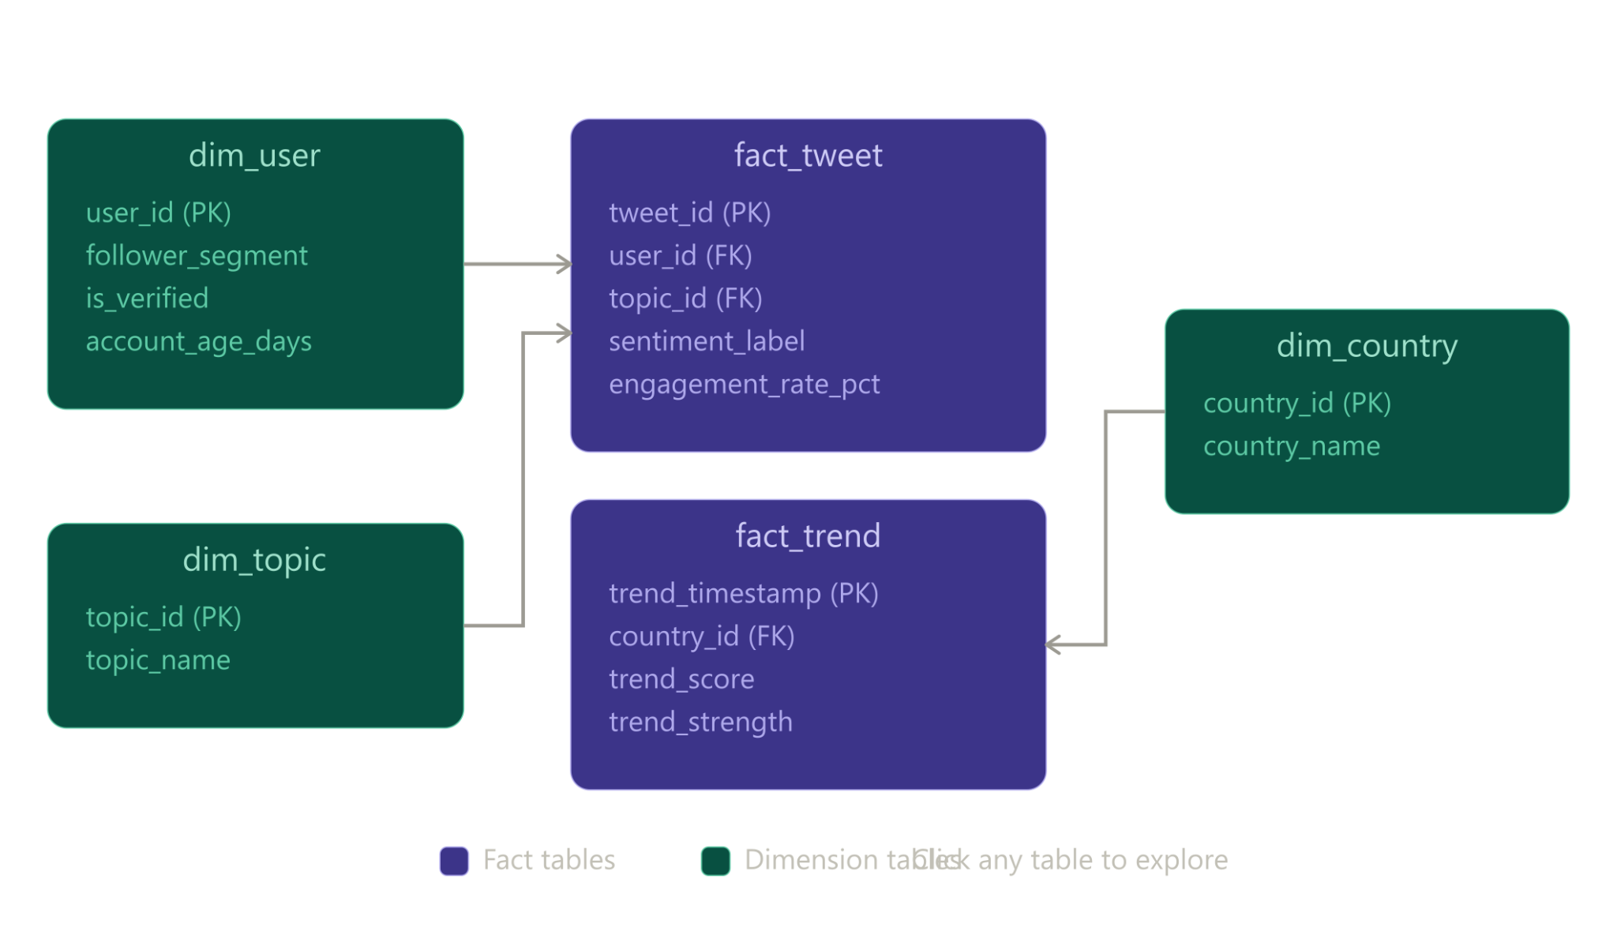
Data Model — Star Schema
Fact and dimension tables designed for efficient analytical queries in Databricks SQL.
Real-Time Social Media Sentiment Analysis Pipeline
10/ 17

Slide 12
Testing & Validation — Data Quality Checks
🥉 Bronze Layer — Raw Ingestion Checks
Schema & table existence verified
Column naming convention (lowercase enforced)
ingested_at never null
NULL threshold < 10% allowed (raw data tolerance)
Basic duplicate awareness
🥈 Silver Layer — Clean Data Checks
Strict duplicate removal on tweet_id & user_id
No nulls in critical columns (tweet_id, tweet_text, user_id)
Sentiment score range validated (−1 to +1)
Timestamp & engagement values verified
Text cleaning confirmed (no empty/null strings)
🥇 Gold Layer — Business Layer Checks
Dimension & fact tables existence confirmed
Soft validations (monitoring, not blocking):
Duplicate user ratio logged
Engagement rate % within 0–100
Sentiment label only: Positive / Negative / Neutral
FK null ratios tracked
Real-Time Social Media Sentiment Analysis Pipeline
11/ 17

Slide 13
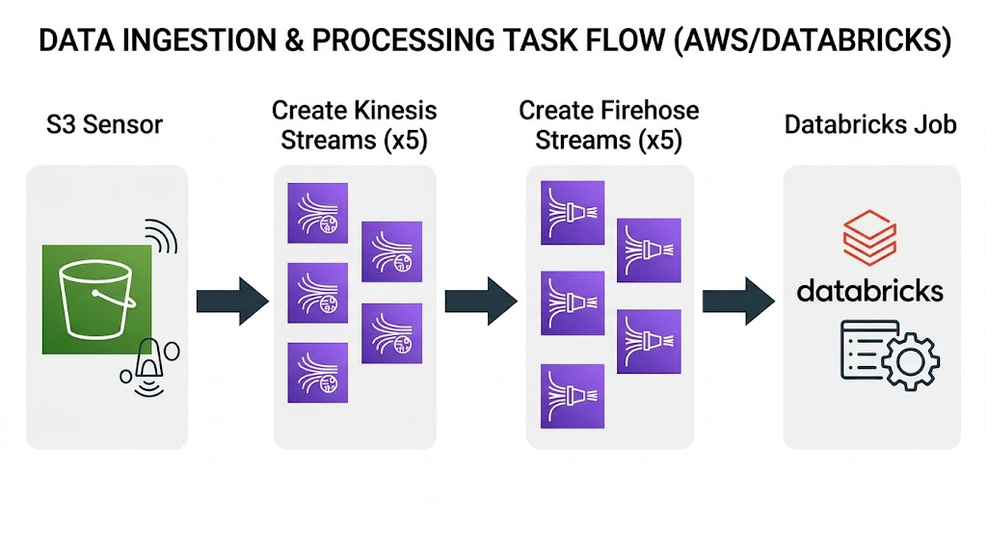
Pipeline Orchestration — Apache Airflow DAG
S3 Sensor
Waits for bronze_*.csv files in source bucket
Polls every 60s, times out at 10 min
Stream Setup (parallel, x5)
Creates 5 Kinesis streams (metadata, sentiment, trends, tweets, valid)
Each Kinesis → paired Firehose → lands in S3 as Parquet
Databricks Trigger
Fires DatabricksRunNowOperator after all streams are ready
Kicks off Bronze → Silver → Gold transformation pipeline
Real-Time Social Media Sentiment Analysis Pipeline
12/ 17

Slide 14
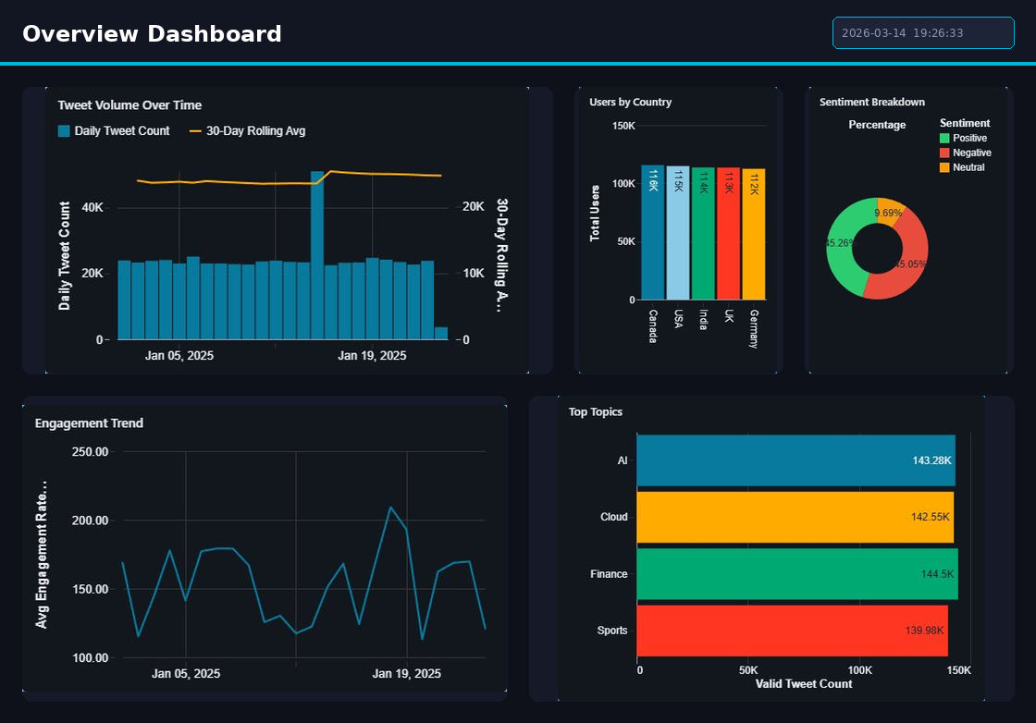
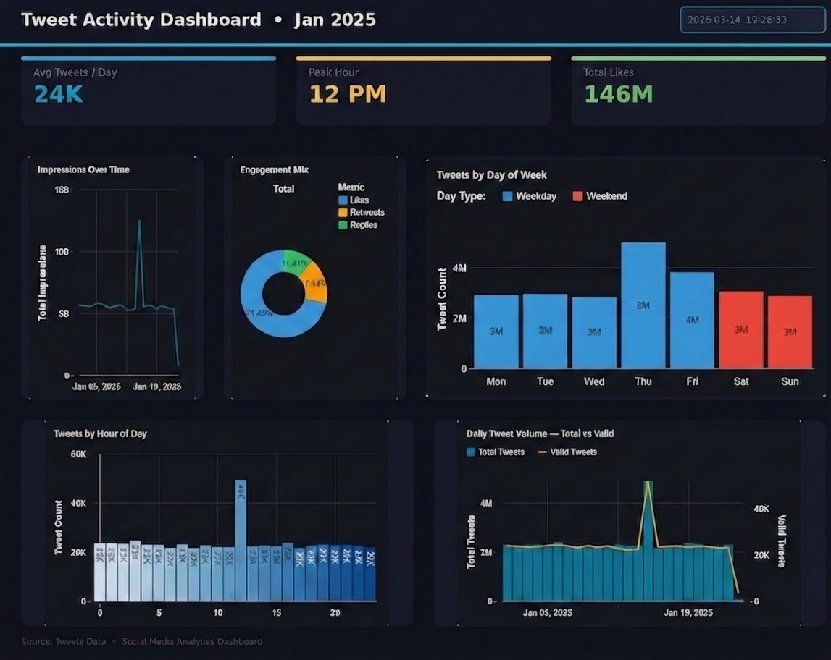
Live Dashboard — Overview, tweet activity
The Overview Dashboard tracks daily tweet volume, sentiment breakdown, and geographic reach across top countries — all in one unified view. It highlights top topics like AI, Finance, Cloud, and Sports while monitoring engagement trends over time.
The Tweet Activity Dashboard highlights key metrics — 24K avg tweets/day, a peak hour at 12 PM, and 146M total likes for January 2025. It breaks down activity by hour, day of week, and engagement mix, showing Thursdays and midday as the highest-traffic windows.
Real-Time Social Media Sentiment Analysis Pipeline
13 / 17

Slide 15
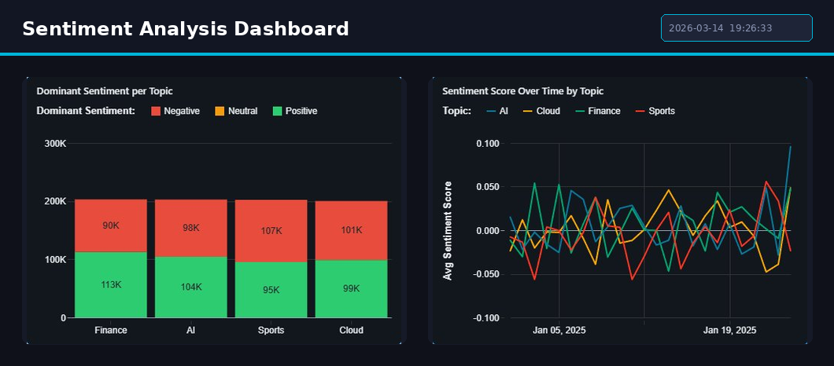
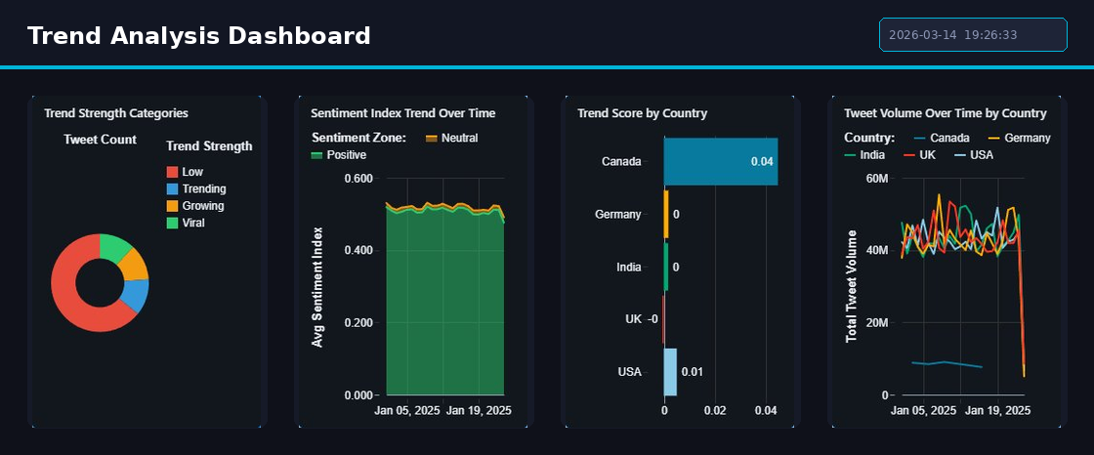
Live Dashboard — Sentiment Analysis, Trend Analysis
Shows positive vs. negative sentiment split across AI, Finance, Cloud, and Sports topics — with Finance leading at 113K positive tweets and sentiment scores fluctuating near neutral throughout January.
Categorizes tweets by trend strength — Low, Trending, Growing, and Viral — with Canada leading in trend score and overall sentiment remaining consistently positive across all five countries throughout January 2025.
Real-Time Social Media Sentiment Analysis Pipeline
14 / 17

Slide 16
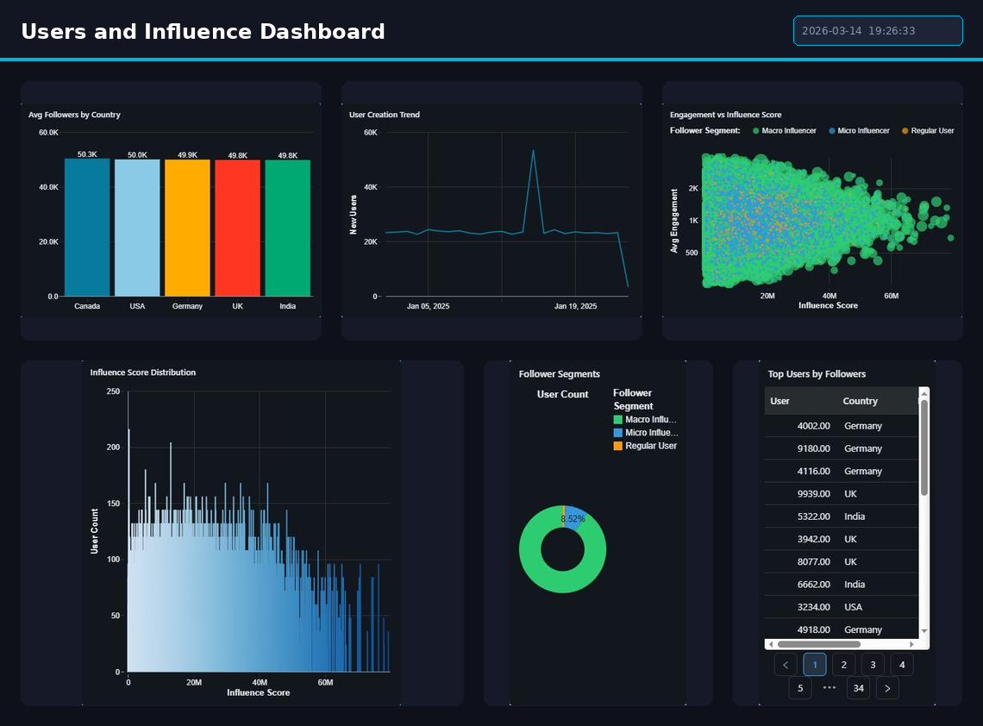
Live Dashboard — Users & influence
Breaks down user influence across countries — Canada leads with ~50K avg followers — segmenting users into Macro Influencers, Micro Influencers, and Regular Users. Higher influence scores clearly correlate with stronger engagement across all regions.
Real-Time Social Media Sentiment Analysis Pipeline
15 / 17

Slide 17





Business Insights
Key findings extracted from the sentiment analysis pipeline across 2020 US election Twitter data.
Sentiment Trends
Trending Topics
Influential Users
Public sentiment spikes sharply during presidential debates and major campaign events, revealing emotional inflection points.
Certain hashtags completely dominate the conversation during major events, with engagement concentrated among a small set.
Verified accounts generate significantly more engagement — 3-5× higher retweet rates compared to non-verified users.
Engagement Analysis
Time-Based Patterns
Pipeline Impact
Real-time insights
delivered in < 60s
end-to-end latency
Tweets expressing strong opinions (positive or negative) consistently attract higher engagement than neutral statements.
Sentiment fluctuates significantly during live political debates, with real-time spikes detectable within minutes.
Real-Time Social Media Sentiment Analysis Pipeline
16 / 17

Slide 18
Thank You
This project demonstrates a scalable ETL pipeline for real-time social media sentiment analysis using modern data engineering tools and best practices.
Amazon Kinesis
Databricks
Apache Spark
Delta Lake
dbt
Power BI
Gullanki Vara Naga Sai Sree · Peruri Sireesha · Sahana P · Subhadip Sasmal
Real-Time Social Media Sentiment Analysis Pipeline
17/ 17

